Slide 1
AS91904 Electronics Outcome
Student Name: Heinrich venter Project Name: Mark Sutherland

Slide 2
Project Details
Describe your project here: This project is a hybrid 70cc pit bike that combines a petrol engine with an 800 W, 36 V electric motor to improve low-speed torque and acceleration. An Arduino Uno R4 WiFi uses analogue and digital Hall effect sensors to monitor throttle position and engine speed, then controls the electric motor through a motor controller. An electromagnetic clutch engages the motor only when assistance is needed, creating a hybrid drivetrain that combines mechanical and electronic systems.

Slide 3
Techniques used
Technique 1: Implementing communication protocols
Evidence:
I will meet this requirement by using I2C communication to connect the Arduino Uno R4 WiFi to the OLED dashboard display. This allows important information such as speed and RPM data to be transferred to the display while only using two communication pins, leaving the remaining pins available for other sensors and system components.
Techniques could be:
implementing communication protocols
Wireless transfer of information
Feedback control
Implementing software flags and interrupts
CAD design, 3D printing, CNC, PCB making
filtering, noise and EMI suppression.
Technique 2: Filtering, noise and EMI suppression
Evidence:
I will meet this requirement by adding filtering components, such as 0.1µF ceramic capacitors, to reduce electrical noise caused by the high-current electric motor. This will improve the reliability of the Hall effect sensors, LED indicators, and battery monitoring system by providing more stable and accurate readings.

Slide 4
Relevant Implications
Description of Implication (What Where Why) | Explanation of Implication (How, Why) | Evidence of addressing.
Accessibility for the pitbike means the bike’s controls, indicators, and basic functions need to be understandable and manageable for a range of riders. This includes clear visual indicators, easy-to-reach switches, and controls that don’t require excessive strength. | It is important because riders need to operate the hybrid system, throttle, and display safely without confusion. I will address this by using clearly labelled switches, simple control layouts, and making sure components like the electric–petrol mode indicator are easy to read.
Usability relates to how easy it is to understand and use the pitbike’s hybrid systems, such as switching modes, checking battery levels, or starting the bike. The design needs to feel intuitive even for new riders. | It matters because if the interface is confusing, the rider could misuse the bike or struggle during operation. I will address this by keeping the hybrid controls simple, limiting unnecessary switches, and providing a logical layout similar to standard pitbikes so it feels familiar.
Functionality refers to how well the 70cc hybrid pitbike performs its intended purpose—delivering reliable petrol and electric operation, smooth power delivery, and stable riding. It also includes ensuring the components (battery, controller, mechanical systems) work together correctly. | It is important because the bike must be reliable and safe. I will address this by testing the hybrid system regularly, checking wiring, ensuring the mechanical and electrical parts don’t interfere with each other, and confirming that power output remains stable.
Aesthetics for the pitbike include the visual design—how the hybrid components are integrated, how tidy the wiring is, and the overall look of the bike. A clean, professional aesthetic helps the bike feel intentional rather than thrown together. | It is important because a well-presented bike improves user confidence and makes maintenance easier. I will address this by organising wiring neatly, using matching colours or covers, and ensuring added components blend with the original frame so the hybrid upgrade looks cohesive.

Slide 5
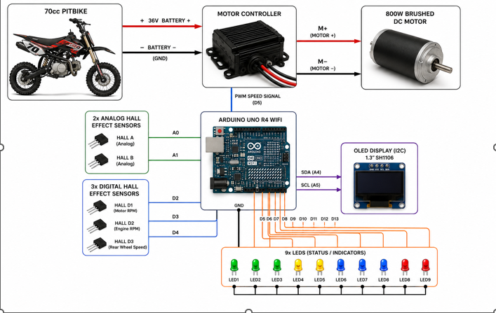
Original Design
Insert diagram here of electronics outcome

Slide 6
Behaviour and function
The behaviour of the electronics is as follows.
Electric Motor Control
An analogue Hall effect sensor is used as the throttle input to send a signal to the 36 V motor controller, which controls the 800 W electric motor.
A 36 V to 12 V DC-DC buck converter is used to safely power the Arduino Uno R4 WiFi from the bike’s main battery system.
Hybrid Power Switching
A 24 V electromagnetic clutch is used to connect and disconnect the electric motor from the drivetrain.
Both the petrol engine and electric motor provide power during acceleration to improve low-speed torque.
At higher speeds, the electric motor disengages because the petrol engine can operate at a higher RPM.
A second Hall effect sensor is connected to the clutch lever, allowing the rider to manually disengage the electric motor when required.
RPM Matching System
Two digital Hall effect sensors measure the RPM on both sides of the electromagnetic clutch.
The Arduino uses this data to match the electric motor speed with the drivetrain before engaging the clutch, preventing drivetrain damage and sudden speed changes.

Slide 7
Speed Monitoring
A digital Hall effect sensor mounted near the rear wheel measures wheel rotation speed.
The Arduino calculates the bike’s speed and displays it on the dashboard.
Battery and Fuel Monitoring
A resistor and capacitor voltage divider circuit measures battery voltage and sends a readable signal to the Arduino.
A fuel flow sensor detects fuel movement through the fuel line, allowing the system to estimate fuel availability.
Dashboard Display
An OLED display and LED indicators provide the rider with real-time information.
The dashboard displays:
Vehicle speed
Engine RPM
Electric motor RPM
Battery percentage

Slide 8
Explaining relevant communication protocols
I am using I2C communication between the Arduino Uno R4 WiFi and the OLED dashboard display. I2C works by using two communication lines: SDA (Serial Data) to transfer information and SCL (Serial Clock) to synchronise the data transfer. The Arduino acts as the master device, sending information to the OLED display, which acts as the slave device. This allows the system to display real-time information such as speed, RPM, and battery voltage.
I selected I2C because it only requires two Arduino pins, leaving more available pins for the other sensors used in the bike, such as Hall effect sensors and RPM sensors. I2C also provides enough communication speed for a small OLED display while allowing additional devices to be added to the same communication bus in the future.

Slide 9
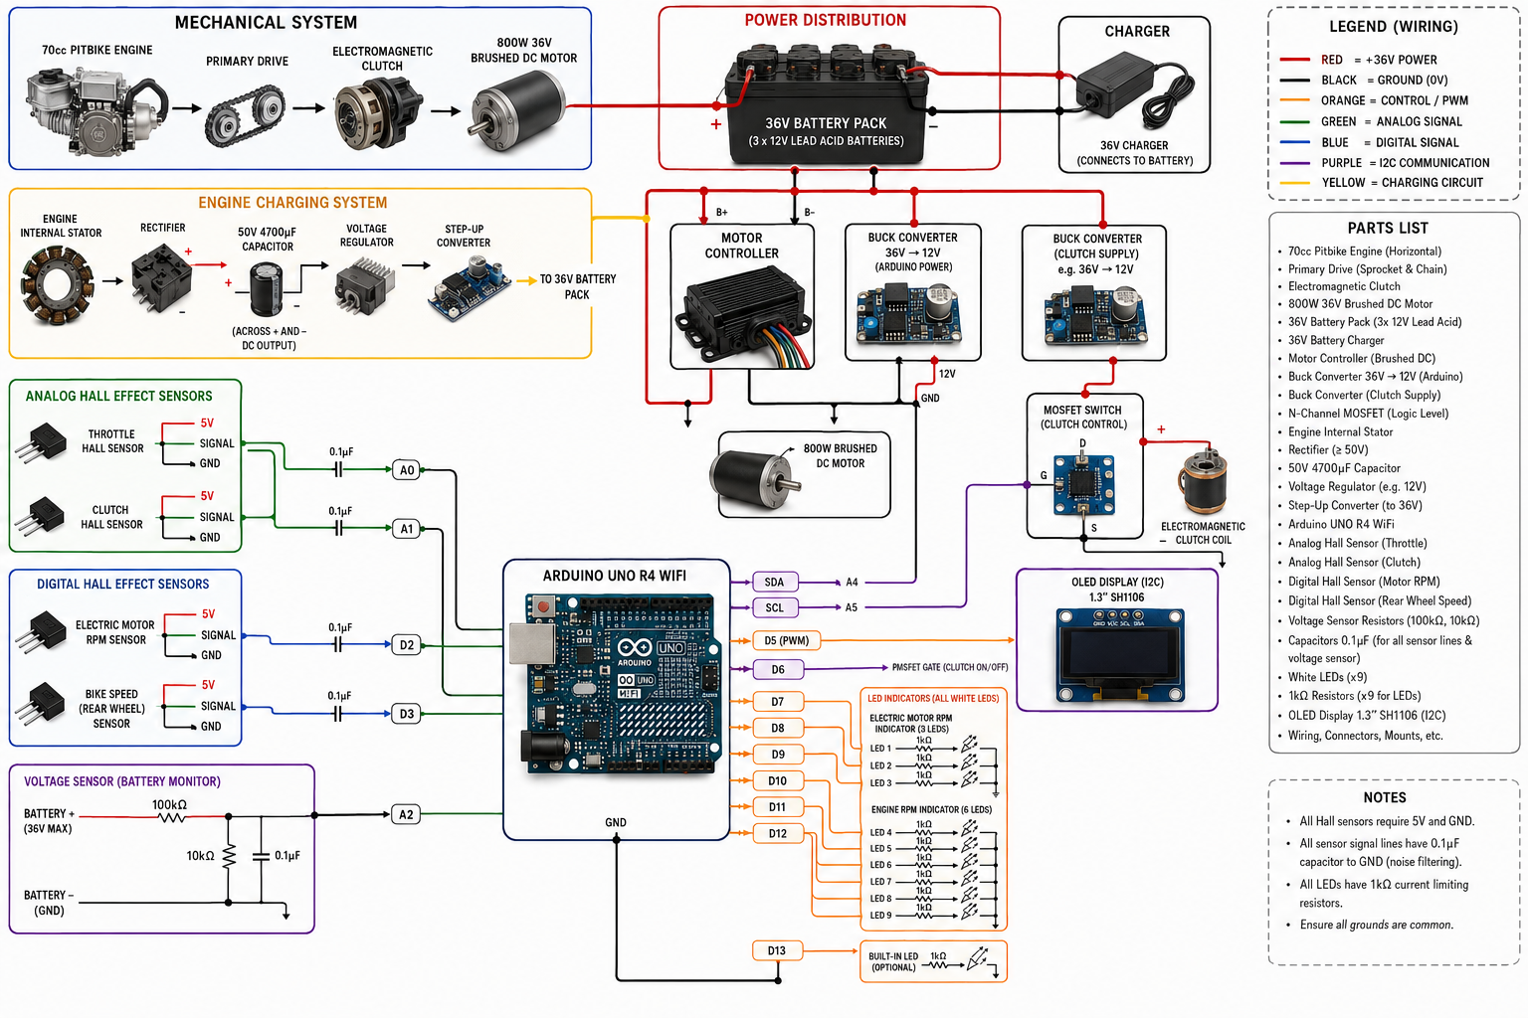
Iterated Design
Feedback:

Slide 10
Components and Systems

Slide 11
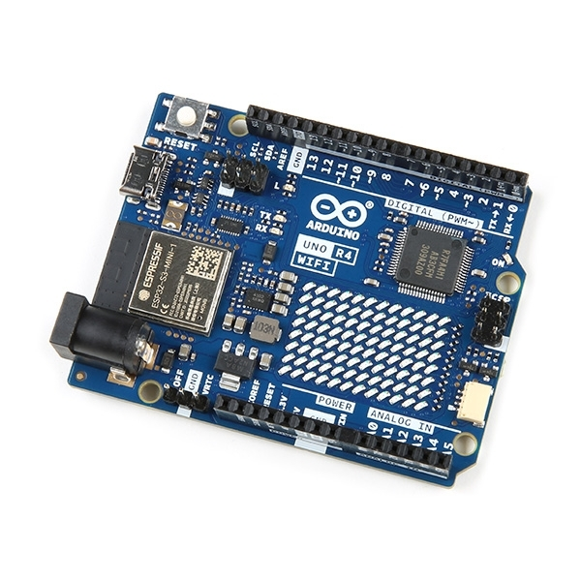
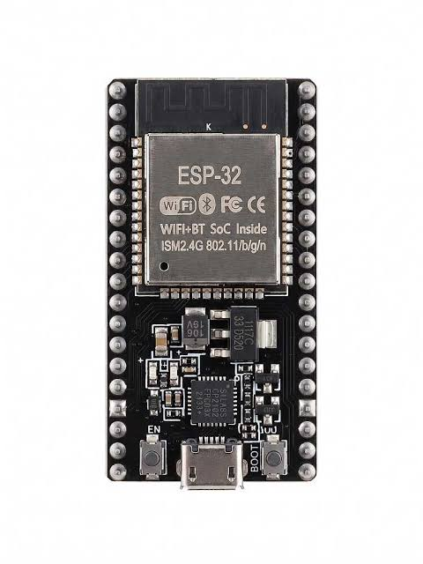
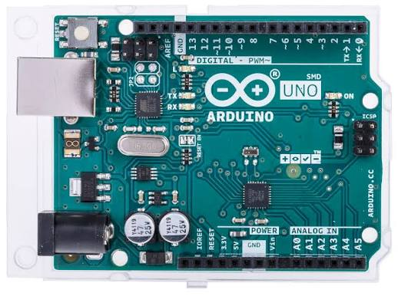
Choice of Component/System 1: controller
Chosen
Ardunio R4
Alternative 1
Esp 32
Alternative 2
Arduino r3
Justification of choice made
I chose the Arduino r4 over the esp 32 because is have a fundamental understranding on the workings of the Arduino compared to a the esp32 which ive never used before. I chose the r4 over the r3 because the r4 has a wifi chip on board which means that I can made a ui to adjust settings like throttle logic and sensitivity and when I need to do maintenance I can turn stuff of like the clutch for example

Slide 12
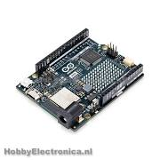
Component/System 1
Explanation of component-brain
The Arduino Uno R4 WiFi is the main microcontroller used in my project. It uses a 32-bit processor, which gives it more processing power compared to older Arduino boards, and it also includes built-in WiFi and Bluetooth capabilities. I chose this board because it has enough processing power to handle multiple sensors, control systems, and communication with the dashboard while still keeping the simple Arduino layout and 5V compatibility.
Component Picture
Component test log: very easy to control and upload code through a cable but still working on the uploading over wifi.

Slide 13
Reliability Testing
Multiple test
Reliability notes from testing: the analog hall sensors have a very jumpy signal
Analyse notes from testing and note changes to be made: through feedback ive found that incorporating a 0.1uf capacitor across the signal and ground wires of the sensors it can smoot the signal out to a very clear and stable signal, adding a 1k resisitor to the leds can make it slightly dimmer and can also make its longevity of the leds much greater cause the heat is greatly decreased, meaning that the chance of it blowing goes down cause the voltage is decreased that goes to the led itself

Slide 14
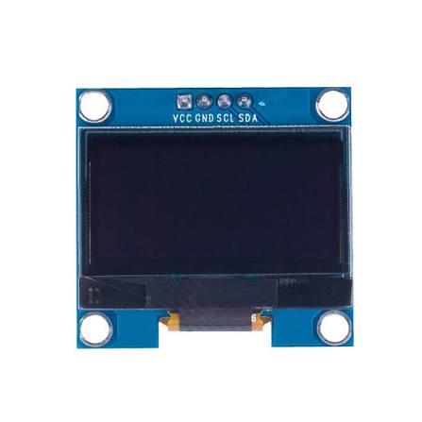
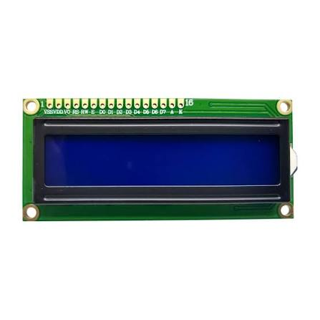
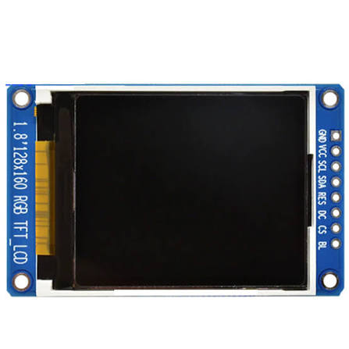
Choice of Component/System 2
Chosen
1.3” i2c Oled screen
Alternative 1
Lcd screen
Alternative 2
SPI TFT colour display
Justification of choice made
The chosen 1.3" I2C OLED display was selected because it provides a clear and efficient way to display information from the Arduino. Its 128x64 resolution allows it to show detailed data such as speed, RPM, and battery levels while using very little power. Compared to a standard LCD, the OLED has better viewing angles and does not require a power-hungry backlight. I also chose it over an SPI TFT display because I2C only uses two communication pins (SDA and SCL), leaving more Arduino pins available for the other sensors and reducing wiring complexity.

Slide 15
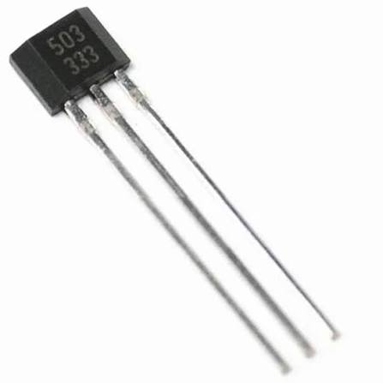
Component/System 2
Explanation of component-speed/rpm sensing
The speed and RPM tracking system uses digital Hall effect sensors with neodymium magnets attached to the rotating parts of the bike, including the clutches and rear wheel. When the magnet passes the sensor, it detects the change in the magnetic field and sends a digital signal (0V or 5V) to the Arduino. These signals are used by the Arduino to calculate the RPM of the drivetrain and the speed of the bike by measuring the time between each pulse.
Component Picture
Component Test Log: A 0.1µF smoothing capacitor was added between the signal and ground lines to reduce electrical noise and stabilise the sensor readings. After adding the capacitor, the Arduino received cleaner and more consistent signals, with no missed pulses or false readings during testing. This confirmed that the subsystem was working correctly and passed the test.

Slide 16
Reliability Testing
Test your circuits at least 10 times
Reliability Notes from Testing: A 0.1µF decoupling capacitor was added between the signal line and ground before trial 5 to reduce electrical noise. After this change, the sensor readings became much more stable. During the remaining six trials, the sensor produced consistent results with no false triggers, showing that the system was reliable and repeatable.
Analysis Notes from Testing and Changes to be Made: The 0.1µF ceramic capacitor will be permanently added to the PCB near the sensor input pins to help reduce electrical noise and improve signal stability. For future versions, shielded twisted-pair cables could be used for external sensor connections to further reduce interference from the engine and other electrical components.

Slide 17
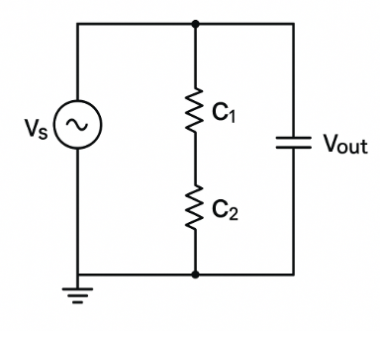
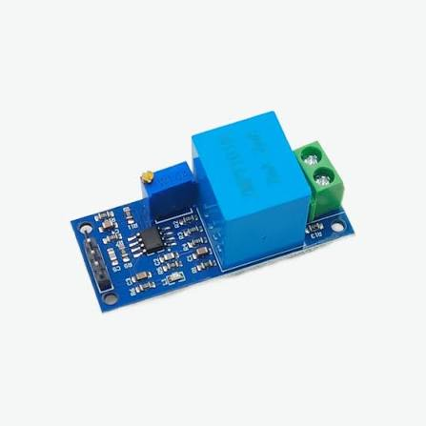
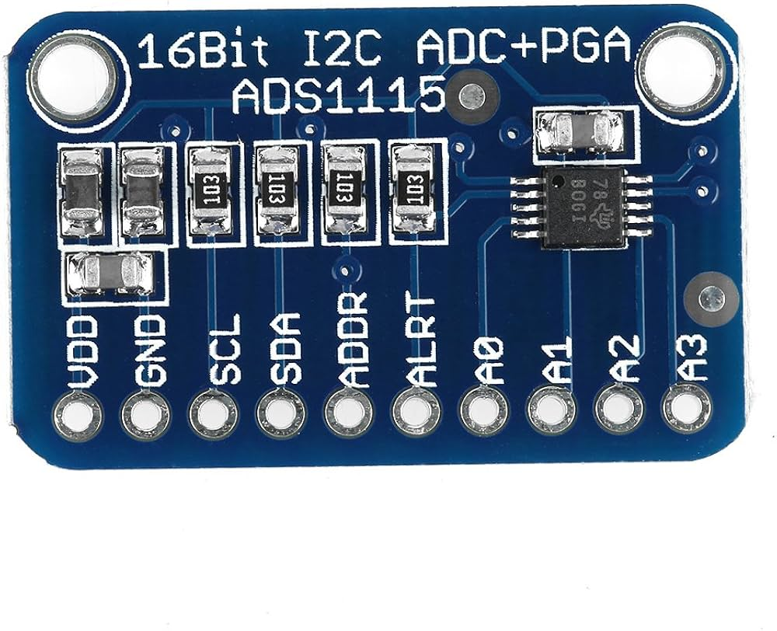
Choice of Component/System 3
Chosen
Resistor Voltage Divider Circuit with a 0.1 uf filtering capacitor
Alternative 1
Dedicated Analog Voltage Sensor Module (eg, ZMPT101B or standard voltage sensor breakout).
Alternative 2
Digital I2C Analog-to-Digital Converter (ADC) Module (eg, ADS1115 breakout).
Justification of choice made
The custom resistor voltage divider was chosen because it provides a simple and low-cost way to measure the battery voltage safely with the Arduino. The voltage divider reduces the higher battery voltage down to a 0-5V signal that the Arduino can read. A pre-built voltage sensor module was not used because it performs the same function but takes up more space and increases the cost of the system. A digital I2C ADC module was also unnecessary because the Arduino’s built-in ADC has enough accuracy for monitoring the battery level. A 0.1µF capacitor was added to reduce electrical noise from the motor and improve the stability of the voltage readings.

Slide 18
Component/System 3
Explanation of component-dashboard
The visual indicator system uses led to provide the rider with quick information about the bike’s condition, such as low battery warnings or system errors. Each led has a 1k ohm resistor connected in series to limit the current and protect both the led and the Arduino output pins from damage. The Arduino controls the leds through its digital pins by switching them between high and low states depending on the sensor information it receives.
Component Picture
Component Test Log: The purpose of this test was to check that the LED indicators could switch on and off correctly without causing issues for the Arduino pins or flickering during operation. The LED circuit was built with a 1kΩ resistor in series to limit current. During initial testing, the LEDs worked correctly, but electrical noise from the motor power system caused slight flickering. A 0.1µF capacitor was added to help smooth the signal and remove the fluctuations. After this change, the LEDs operated consistently through ten test cycles with no failures, confirming that the system passed.

Slide 19
Reliability Testing
Test your circuits at least 10 times
Reliability Notes from Testing: The led indicator circuit was tested through 10 switching cycles to check its reliability during operation. During the first three tests, the led showed some flickering when the 800W motor was running, which was caused by electrical noise affecting the Arduino’s output signal. Before the fourth trial, a 0.1uF capacitor was added to smooth the output signal along with the 1k ohm current-limiting resistor. In the remaining seven tests, the ledsoperated consistently with no flickering or signal issues, showing that the changes improved the reliability of the system.
Analyse notes from testing and note changes to be made:

Slide 20
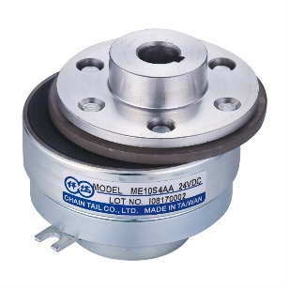
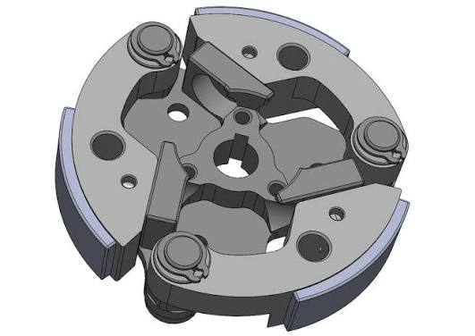
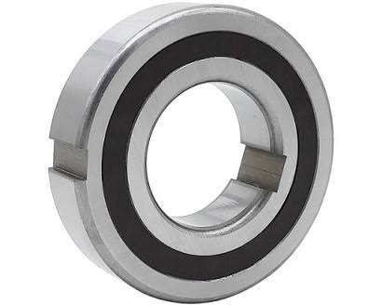
Choice of Component/System 4
Chosen
Electromangetic clutch
Alternative 1
Automatic Centrifugal Clutch Mechanism.
Alternative 2
One way bearing
Justification of choice made
I chose the electromagnetic clutch because, when a electric motor gets back driven it can cause something called back emf which is basically electric breaking but with a electromagnetic clutch yon can physically disconnect the 2 power units from each other specifically the electric motor which mean no back emf.

Slide 21
Component/System 4
Explanation of component-electromagnetic clutch
The clutch system is used to connect and disconnect the 800W electric motor from the drivetrain. It uses a mechanical clutch mechanism controlled by a lever, with a sensor attached to detect when the clutch is being used. When the rider pulls the lever, the clutch disengages the motor from the drivetrain, allowing the motor to be safely disconnected. The sensor sends this information to the Arduino, allowing it to stop motor assistance and adjust the system accordingly.
Component Picture
Component Test Log: The purpose of this test was to check that the manual clutch could reliably engage and disengage the 800W motor from the drivetrain. The clutch was connected to the motor system and tested under load to ensure it could separate the drive components correctly. Initial testing showed some resistance in the lever mechanism, causing the clutch plates to separate slowly. The linkage was cleaned, adjusted, and lubricated to fix this issue. After these changes, the clutch successfully completed ten engagement and disengagement tests without slipping, confirming that it worked correctly.

Slide 22
Reliability Testing
Test your circuits at least 10 times
Reliability notes from testing:
Manual clutch assembly stress trials revealed initial instability and wobble, which were corrected by manually aligning the central hub to ensure proper clearance. Following this adjustment, the system demonstrated consistent, reliable performance throughout the remaining tests without mechanical failure.
Analysis Notes from Testing and Changes to be Made: Testing showed that the high torque produced by the 800W motor puts significant load on the clutch assembly, making correct alignment important for reliable operation. Small amounts of misalignment can cause extra stress and increased wear on the drivetrain components. To improve the strength and reliability of the system, a custom sleeve will be manufactured to act as a central alignment piece. This will help keep the clutch and drivetrain components correctly positioned, reducing movement and improving long-term durability.

Slide 23
Final Outcome, Before Testing
Include a screenshot/video of the final outcome working before testing here

Slide 24
Iteration of Development
Feedback on reliability and functionality of the system:
Changes based off feedback (include picture or design):

Slide 25
Testing and Debugging

Slide 26
Testing for functionality
Project Specification | Test | Issues to be fixed, debugging, Notes
Examples of testing, modifying and debugging include: using testing devices and testing strategies, testing expected, boundary and invalid inputs, changing board layout, improving component selection. You may test as you go

Slide 27
Testing for reliability
Potential problem, original reliability | Test and change for reliability | Issues to be fixed, debugging, Notes

Slide 28
Iteration after testing
Feedback after testing:
Changes based off feedback (include picture or design):

